Slide 1



Noida Institute of Engineering and Technology, Greater Noida
Introduction to Computer Vision
Unit: 1
Subject Name:
Computer Vision
Faculty Name:
Subhas Chandra
Affiliation:
Assistant Professor
Department:
AIML
Course Details:
B.Tech 7th Sem

Slide 2

Brief Introduction About Me
Name:- K Prabhanjan kumar
Assistant Professor, IT
NIET , Greter Noida
Qualification
Post Graduated from Pydah Engineering college VIZAG affiliated under JNTU KAKINADA, Andhra Pradesh.
Graduation from Prakasam Engineering college Kandukur affiliated under JNTU KAKINADA, Andhra Pradesh.
Teaching Experience : 9 Years
Technical skills
Big Data & Eco System : Hadoop, Hive, Pig, Sqoop, Flume,
Oozie.
Nosql Databases : Hbase.
Database Languages : Oracle 10g,Mysql.
Operating Systems : Windows Family, Linux (Ubuntu).
Programming Languages : C,Core-java.
IDE : Eclipse.

Slide 3
UNIT-I
UNIT-I: Introduction to Computer Vision:
Introduction to Computer Vision
Computer Vision, Research and Applications, (Self-Driving Cars, Facial Recognition, Augmented & Mixed Reality, Healthcare). Most popular examples Categorization of Images, Object Detection, Observation of Moving Objects, Retrieval of Images Based on Their Contents, Computer Vision Tasks classification, object detection, Instance segmentation. Convolutional Neural Networks, Evolution of CNN Architectures for Image, Recent CNN

Slide 4
UNIT-II
UNIT-II: Architectures
Architectures
Representation of a Three-Dimensional Moving Scene. Convolutional layers, pooling layers, and padding. Transfer learning and pre-trained models Architectures.
Architectures Design: LeNet-5, AlexNet, VGGNet, GoogLeNet, ResNet, Efficient Net, Mobile Net, RNN Introduction.

Slide 5
UNIT-III
UNIT-III: Segmentation
Segmentation
Popular Image Segmentation Architectures, FCN Architecture, Upsampling Methods, Pixel Transformations, Geometric Operations, Spatial Operations in Image Processing, Instance Segmentation, Localisation, Object detection and image segmentation using CNNs, LSTM and GRU’s. Vision Models, Vision Languages, Quality Analysis, Visual Dialogue, Active Contours & Application, Split & Merge, Mean Shift & Mode Finding, Normalized Cuts.

Slide 6
UNIT-IV
UNIT-IV: Object Detection
Object Detection
Object Detection and Sliding Windows, R-CNN, Fast R-CNN, Object Recognition, 3-D vision and Geometry, Digital Watermarking. Object Detection, face recognition instance Recognition, Category Recognition Objects, Scenes, Activities, Object classification.

Slide 7
UNIT-V
UNIT-V: Visualization and Generative Models
Visualization and Generative Models
Object Detection and Sliding Windows, R-CNN, Fast R-CNN, Object Recognition, 3-D vision and Geometry, Digital Watermarking. Object Detection, face recognition instance Recognition, Category Recognition Objects, Scenes, Activities, Object classification.

Slide 8
Syllabus
Unit | Module | Topics Covered
1 | Introduction to Computer Vision: | Computer Vision, Research and Applications, (Self-Driving Cars, Facial Recognition, Augmented & Mixed Reality, Healthcare). Most popular examples Categorization of Images, Object Detection, Observation of Moving Objects, Retrieval of Images Based on Their Contents, Computer Vision Tasks classification, ,object detection, Instance segmentation. Convolutional Neural Networks, Evolution of CNN Architectures for Image, Recent CNN
2 | Architectures | Representation of a Three-Dimensional Moving Scene. Convolutional layers, pooling layers, and padding. Transfer learning and pre-trained models Architectures. Architectures Design : LeNet-5, AlexNet, VGGNet, GoogLeNet, ResNet, Efficient Net, Mobile Net . RNN Introduction, perceptron Backpropagation in CNN,RNN.
3 | Segmentation | Popular Image Segmentation Architectures, FCN Architecture, Upsampling Methods, Pixel Transformations, Geometric Operations, Spatial Operations in Image Processing, Instance Segmentation, Localisation, Object detection and image segmentation using CNNs, LSTM and GRU’s. Vision Models, Vision Languages, Quality Analysis, Visual Dialogue, other attention models, self attention and transformers. Active Contours & Application, Split & Merge, Mean Shift & Mode Finding, Normalized Cuts,
4 | Object Detection | Object Detection and Sliding Windows, R-CNN, Fast R-CNN, Object Recognition, 3-D vision and Geometry, Digital Watermarking. Object Detection, face recognition instance Recognition, Category Recognition Objects, Scenes, Activities, Object classification and detection, Encoder in Code, Decoder in Code, U-Net Code: Encoder, Decoder , Few Shot and zero shot learning, self-supervised learning, Adversarial Robustness, Pruning and model compression, Neural Architecture search, Objects in Scenes. YOLO Fundamentals of Image Formation, Convolution and Filtering.
5 | Visualization and Generative Models | Benefits of Interpretability, Fashion MNIST Class Activation Map code walkthrough, GradCAM,ZFNet.Image compression methods and its requirements,statisticalcompression, spatial compression, contour coding. Deep Generative Models introduction,Generative Adversarial Networks Combination VAE and GAN’s, other VAE and GAN’s deep generative models. GAN Improvements, Deep Generative Models across multiple domains, Deep Generative Models image and video applications.

Slide 9
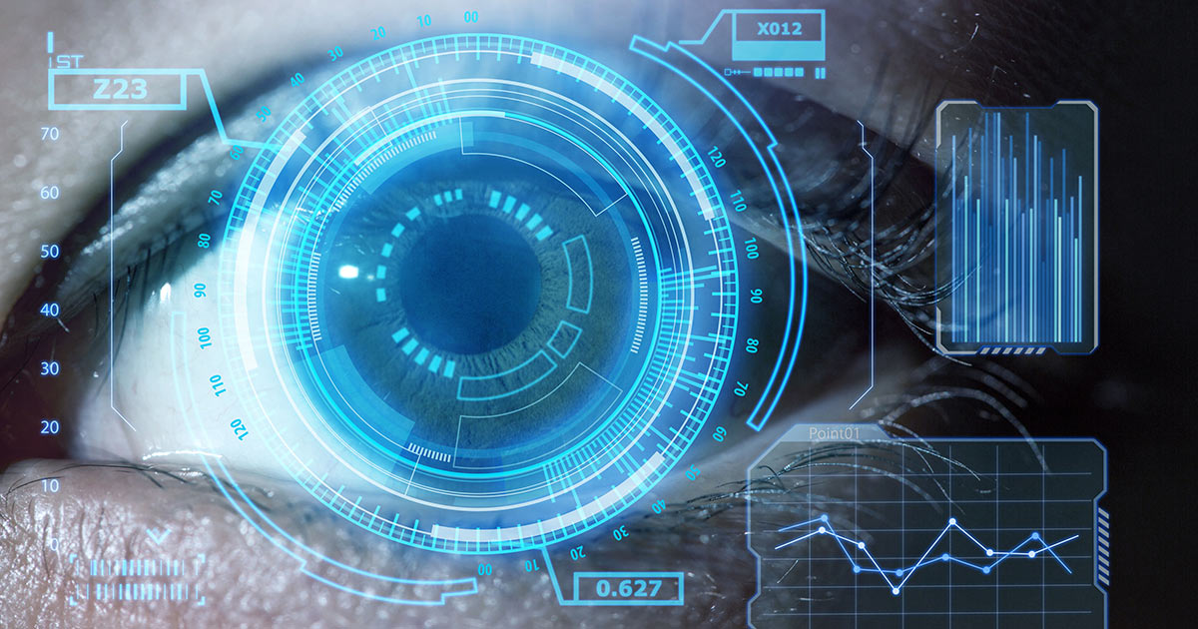
Course Objective
Course Objective: To learn about key features of Computer Vision, design, implement and provide continuous improvement in the accuracy and outcomes of various datasets with more reliable and concise analysis results.

Slide 10
Course Outcome
Course outcome: After completion of this course students will be able to
 | Description | Bloom’s Taxonomy
CO1 | Analyse knowledge of deep architectures used for solving various Vision and Pattern Association tasks. | K4
CO2 | Develop appropriate learning rules for each of the architectures of perceptron and learn about different factors of back propagation. | K2
CO3 | Deploy training algorithm for pattern association with the help of memory network. | K5
CO4 | Design and deploy the models of deep learning with the help of use cases. | K5
CO5 | Understand, Analyse different theories of deep learning using neural networks. | K3

Slide 11
Program Outcome
At the end of the semester, the student will be able:
POs | Engineering Graduates will be able to
PO1 | Engineering Knowledge
PO2 | Problem Analysis
PO3 | Design & Development of solutions
PO4 | Conduct Investigation of complex problems
PO5 | Modern Tool Usage
PO6 | The Engineer and Society
PO7 | Environment and sustainability
PO8 | Ethics
PO9 | Individual & Team work
PO10 | Communication
PO11 | Project management and Finance
PO12 | Life Long Learning

Slide 12
CO-PO and PSO Mapping
Computer vision
CO.K | PO1 | PO2 | PO3 | PO4 | PO5 | PO6 | PO7 | PO8 | PO9 | PO10 | PO11 | PO12
Subject code | 3 |  | 2 |  | 1
Subject code | 2 |  | 1
Subject code |  | 2 |  |  |  | 3
Subject code | 3 | 3 |  | 2
Subject code | 3 |  | 2 |  | 1 |  | 1
avg

Slide 13
Program Educational Objectives(PEOs)
PEO1: To have an excellent scientific and engineering breadth so as to
comprehend, analyze, design and provide sustainable solutions for
real-life problems using state-of-the-art technologies.
PEO2:To have a successful career in industries, to pursue higher studies or
to support enterpreneurial endeavors and to face global challenges.
PEO3:To have an effective communication skills, professional attitude,
ethical values and a desire to learn specific knowledge in emerging
trends, technologies for research, innovation and product
development and contribution to society.
PEO4: To have life-long learning for up-skilling and re-skilling for
successful professional career as engineer, scientist, enterpreneur
and bureaucrat for betterment of society

Slide 14
End Semester Question Paper Template
B TECH
(SEM-VII) THEORY EXAMINATION 20__-20__
DESIGN AND ANALYSIS OF ALGORITHMS
Time: 3 Hours Total Marks: 100
Note: 1. Attempt all Sections. If require any missing data; then choose suitably.
SECTION A
Attempt all questions in brief. 2 x 10 = 20
Q.No. | Question | Marks | CO
1 |  | 2
2 |  | 2
. |  | .
10 |  | 2

Slide 15
End Semester Question Paper Templates
SECTION B
2. Attempt any three of the following: 3 x 10 = 30
SECTION C
3. Attempt any one part of the following: 1 x 10 = 10
Q.No. | Question | Marks | CO
1 |  | 10
2 |  | 10
. |  | .
5 |  | 10
Q.No. | Question | Marks | CO
1 |  | 10
2 |  | 10

Slide 16
End Semester Question Paper Templates
4. Attempt any one part of the following: 1 x 10 = 10
5. Attempt any one part of the following: 1 x 10 = 10
6. Attempt any one part of the following: 1 x 10 = 10
Q.No. | Question | Marks | CO
1 |  | 10
2 |  | 10
Q.No. | Question | Marks | CO
1 |  | 10
2 |  | 10
Q.No. | Question | Marks | CO
1 |  | 10
2 |  | 10

Slide 17
Introduction About Subject With Videos
Computer vision is a field of artificial intelligence (AI) that enables computers and systems to derive meaningful information from digital images, videos and other visual inputs — and take actions or make recommendations based on that information.
Computer Vision covers a huge ground as its applications know no bounds. It often escapes our minds as we fail to notice the role Computer Vision plays in the gadgets, we use day in and day out.

Slide 18
Unit Content
CONTENT
Computer Vision
Research and Applications (Self-Driving Cars, Facial Recognition, Augmented & Mixed Reality, Healthcare).
Most popular examples Categorization of Images
Object Detection
Observation of Moving Objects
Retrieval of Images Based on Their Contents
Computer Vision Tasks classification
object detection
Instance segmentation
Convolutional Neural Networks
Evolution of CNN Architectures for Image
Recent CNN

Slide 19
CO-PO and PSO Mapping
 | PSO1 | PSO2 | PSO3
Subject code |  | 1 | 2
Subject code |  |  | 2
Subject code | 1
Subject code | 1 | 2 | 3
Subject code | 1 | 1 | 2
avg
*3= High *2= Medium *1=Low

Slide 20
PREREQUISITE
Students should have the knowledge of computer organization
Students should know the artificial intelligence basic concepts.
Students should be able to create, design and manipulate the images and idea about pixels

Slide 21
PREREQUISITE
Prerequisites
No prior experience with computer vision is assumed, although previous knowledge of visual computing or signal processing will be helpful (e.g., CSCI 1230). The following skills are necessary for this class:
Math: Linear algebra, vector calculus, and probability. Linear algebra is the most important and is required.
Data structures: You will write code that represents images as matrices, high-dimensional features, and geometric constructions.
Programming and toolchains: A good working knowledge. Intro CS is required, and an intermediate systems course is strongly encouraged.

Slide 22
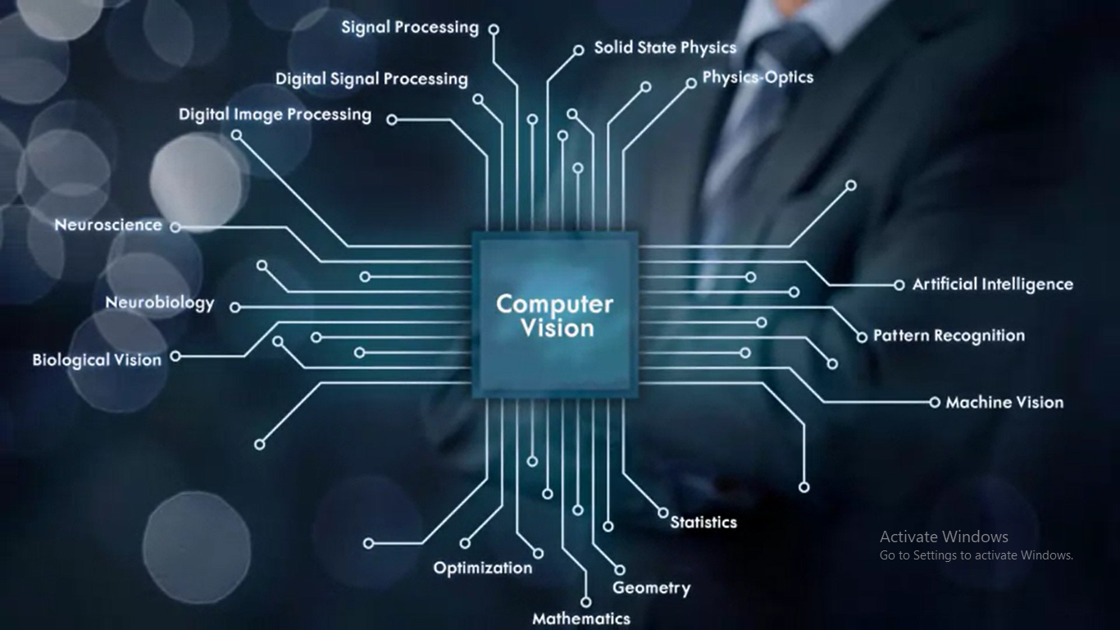
Computer Vision

Slide 23
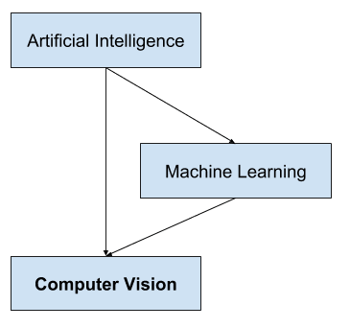
Computer Vision
a field of study that seeks to develop techniques to help computers “see” and understand the content of digital images such as photographs and videos.
It is a multidisciplinary field that could broadly be called a subfield of artificial intelligence and machine learning, which may involve the use of specialized methods and make use of general learning algorithms.

Slide 24
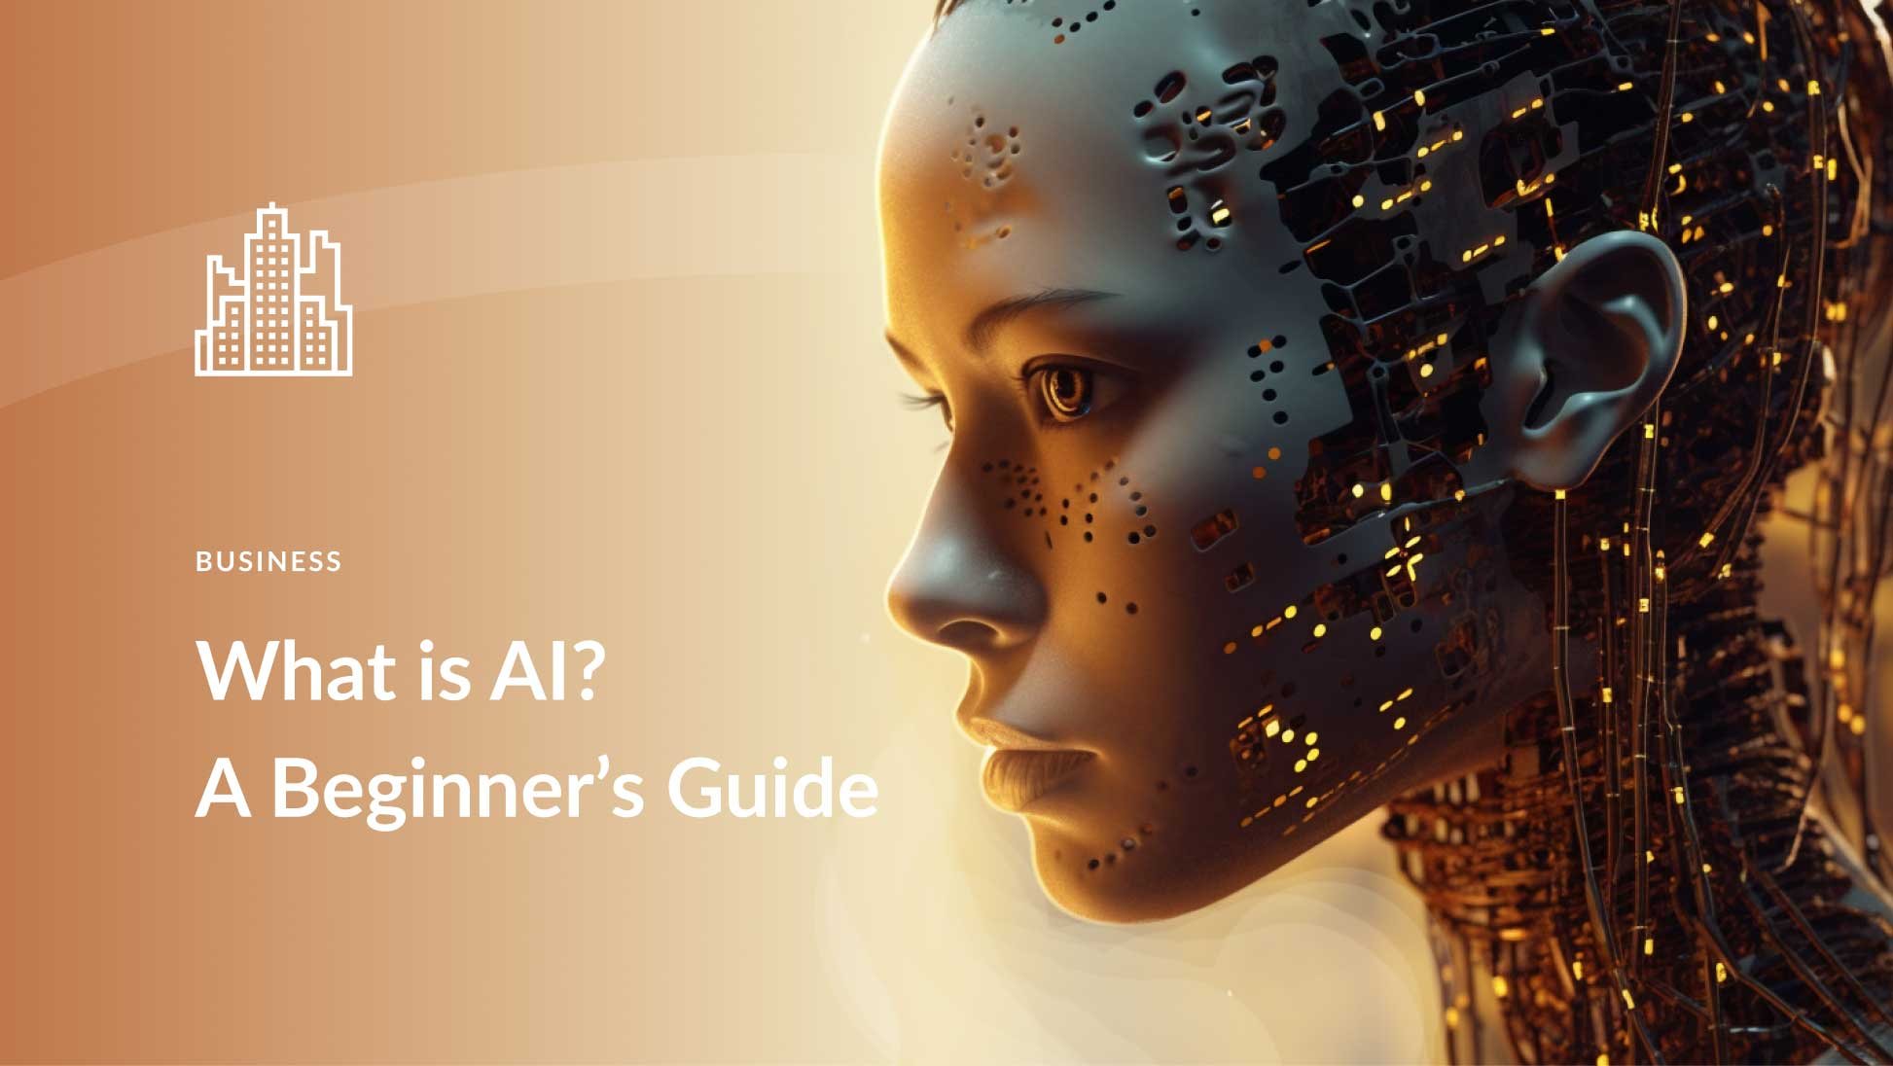
Computer Vision
Artificial intelligence (AI), also known as machine intelligence, is a branch of computer science that focuses on building and managing technology that can learn to autonomously make decisions and carry out actions on behalf of a human being.

Slide 25
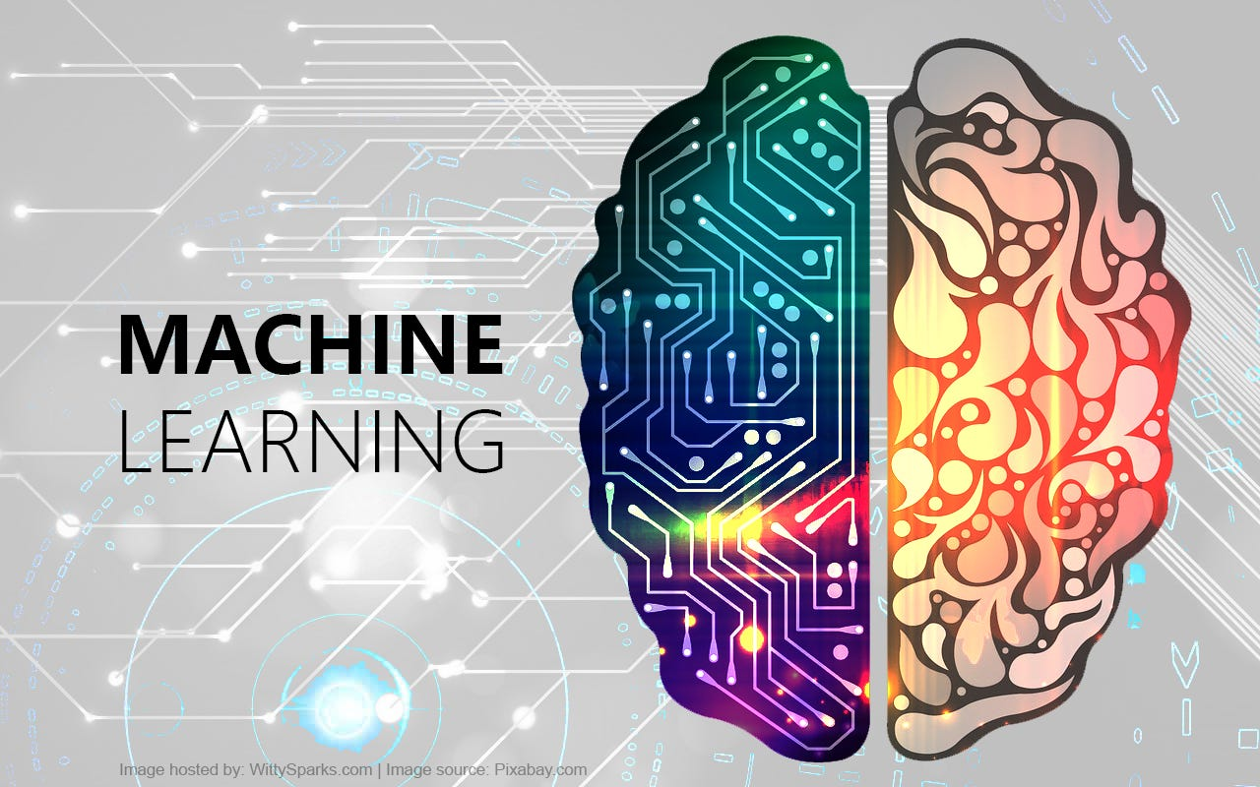
Computer Vision
What is machine learning?
Machine learning is a subfield of artificial intelligence, which is broadly defined as the capability of a machine to imitate intelligent human behavior. Artificial intelligence systems are used to perform complex tasks in a way that is similar to how humans solve problems.

Slide 26
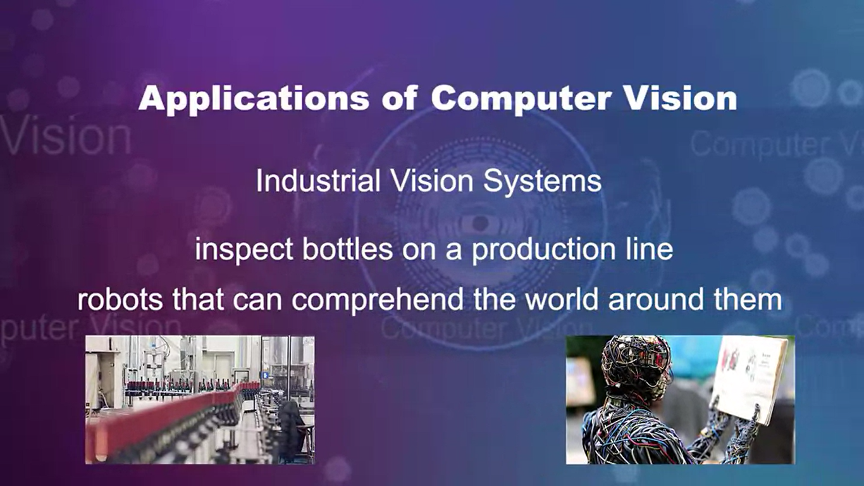
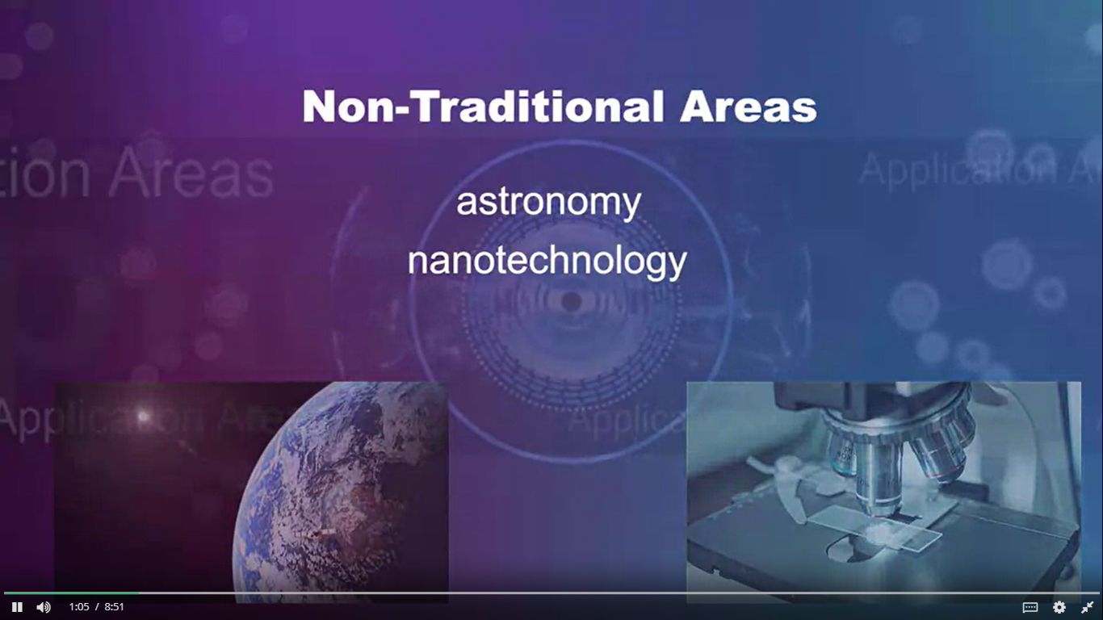
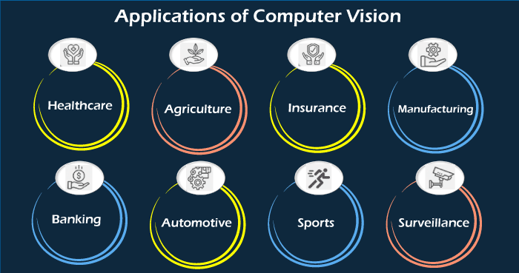
Computer Vision Applications

Slide 27
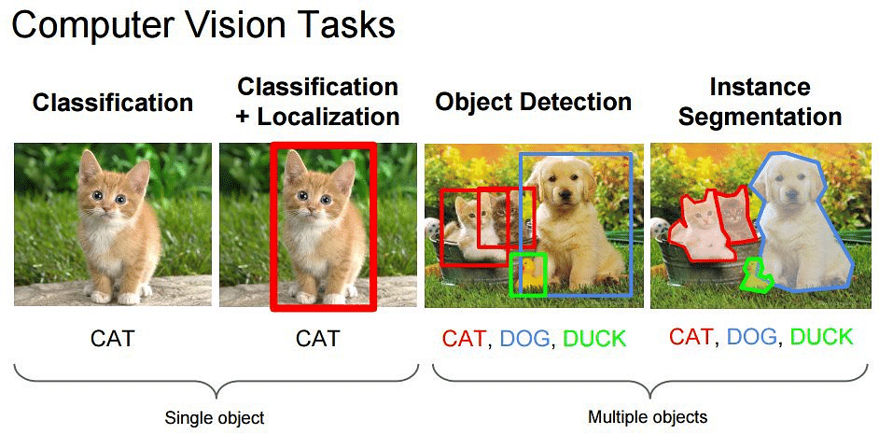
Computer Vision Applications
Computer Vision Applications
Self-Driving Cars
Facial Recognition
Augmented & Mixed Reality
Healthcare
Categorization of Images
Object Detection
Observation of Moving Objects
Retrieval of Images Based on Their Contents

Slide 28
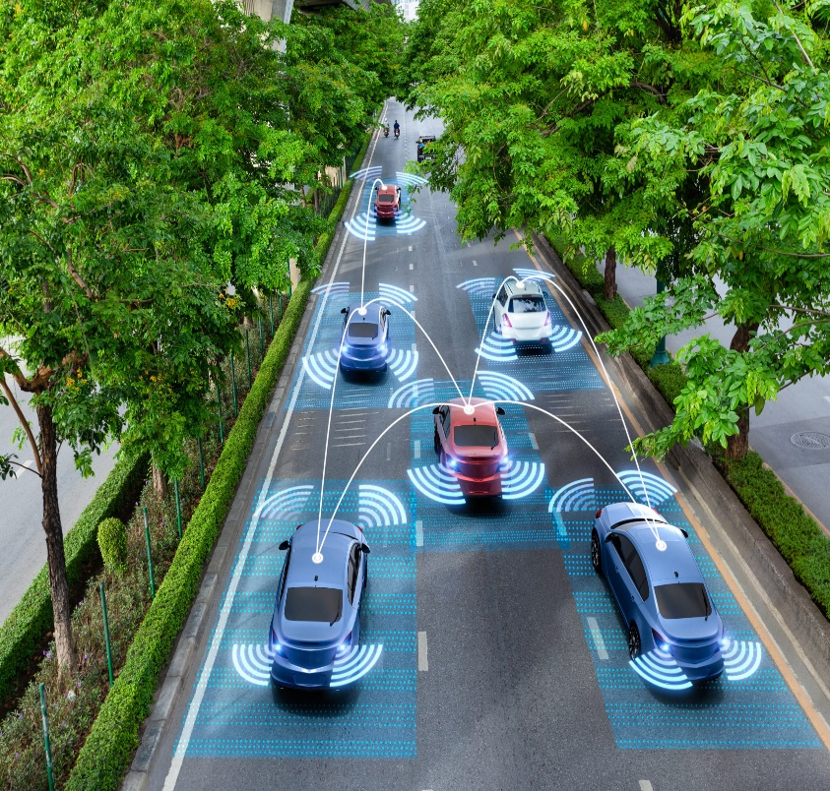
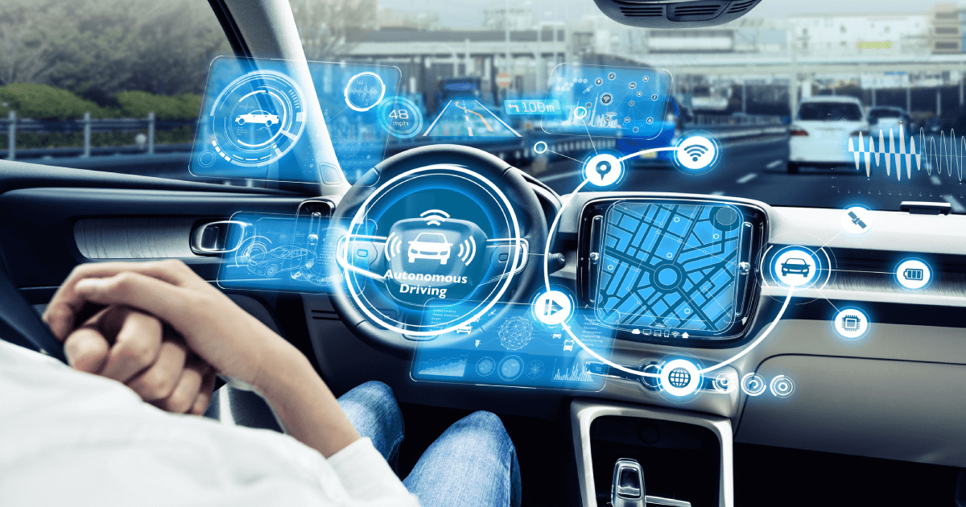
Self Driving cars
An autonomous car is a vehicle capable of sensing its environment and operating without human involvement. A human passenger is not required to take control of the vehicle at any time, nor is a human passenger required to be present in the vehicle at all. An autonomous car can go anywhere a traditional car goes and do everything that an experienced human driver does.

Slide 29
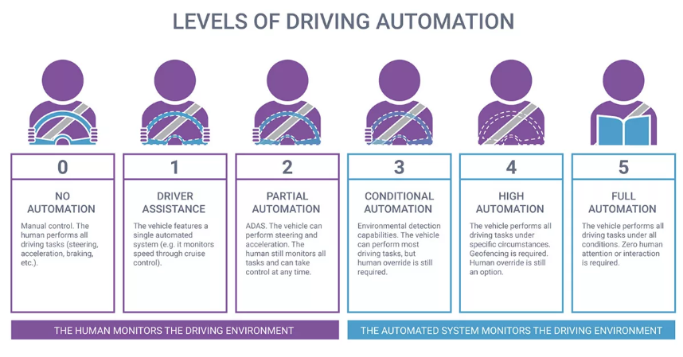
Self Driving cars
The Benefits Of Autonomous Cars
Reduce traffic congestion (30% fewer vehicles on the road)
Cut transportation costs by 40% (in terms of vehicles, fuel, and infrastructure)
Improve walkability and livability
Free up parking lots for other uses (schools, parks, community centers)
Reduce urban CO2 emissions by 80% worldwide

Slide 30
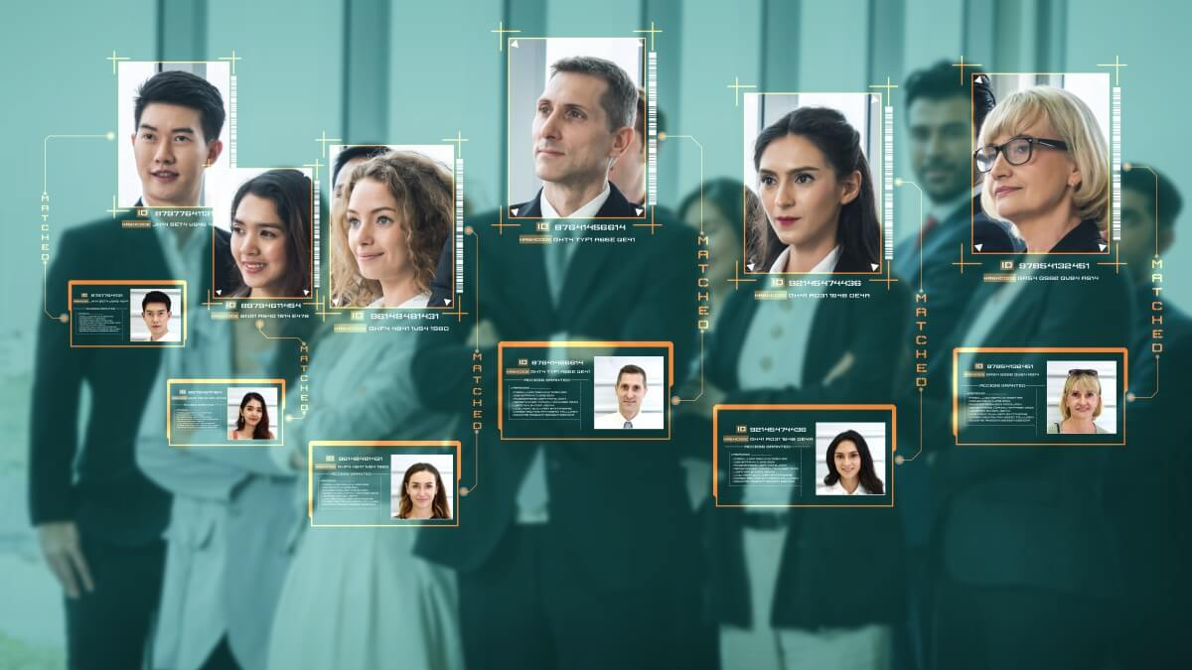
facial recognition
What is facial recognition?
Facial recognition is a way of identifying or confirming an individual’s identity using their face. Facial recognition systems can be used to identify people in photos, videos, or in real-time.
Procedure
Step 1: Face detection
Step 2: Face analysis
Step 3: Converting the image to data
Step 4: Finding a match
How facial recognition is used
Unlocking phones
Law enforcement
Airports and border control
Finding missing persons
Reducing retail crime
Improving retail experiences
Banking
Marketing and advertising
Healthcare
Tracking student or worker attendance
Recognizing drivers
Monitoring gambling addictions

Slide 31
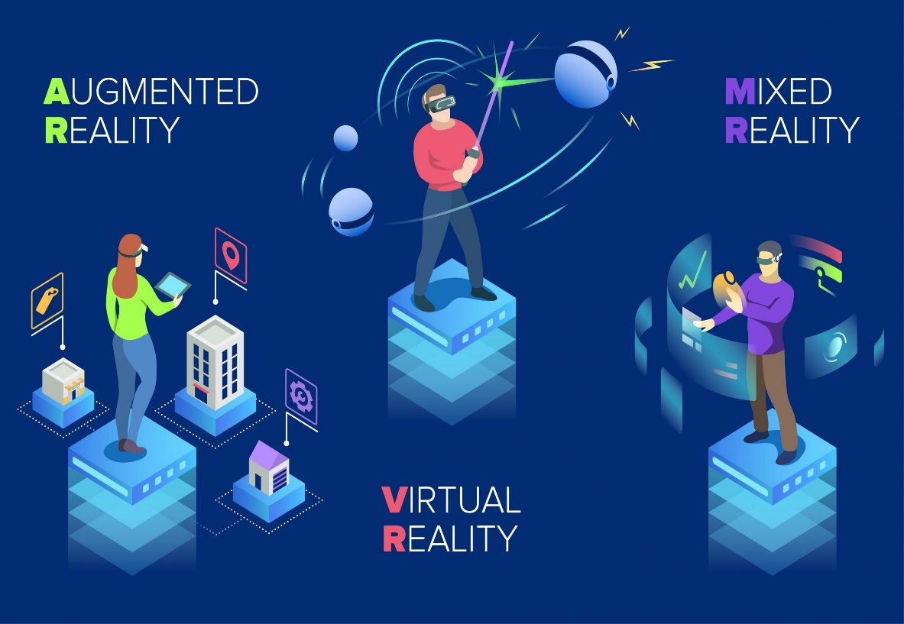
Augmented & Mixed Reality
Augmented reality is an interactive experience that enhances the real world with computer-generated perceptual information.
Virtual Reality (VR) is a computer-generated environment with scenes and objects that appear to be real, making the user feel they are immersed in their surroundings. This environment is perceived through a device known as a Virtual Reality headset or helmet.
Mixed reality (MR) is an emergent technology that blends virtual reality (VR) and augmented reality (AR). Mixed reality headsets like the Microsoft HoloLens are opening up possibilities in the gaming world for mixed reality experiences. These head-mounted displays include cameras that constantly map the wearer’s environment. When you play games made for these devices, characters can walk around the physical world you’re in and even help themselves to a seat on your couch.

Slide 32
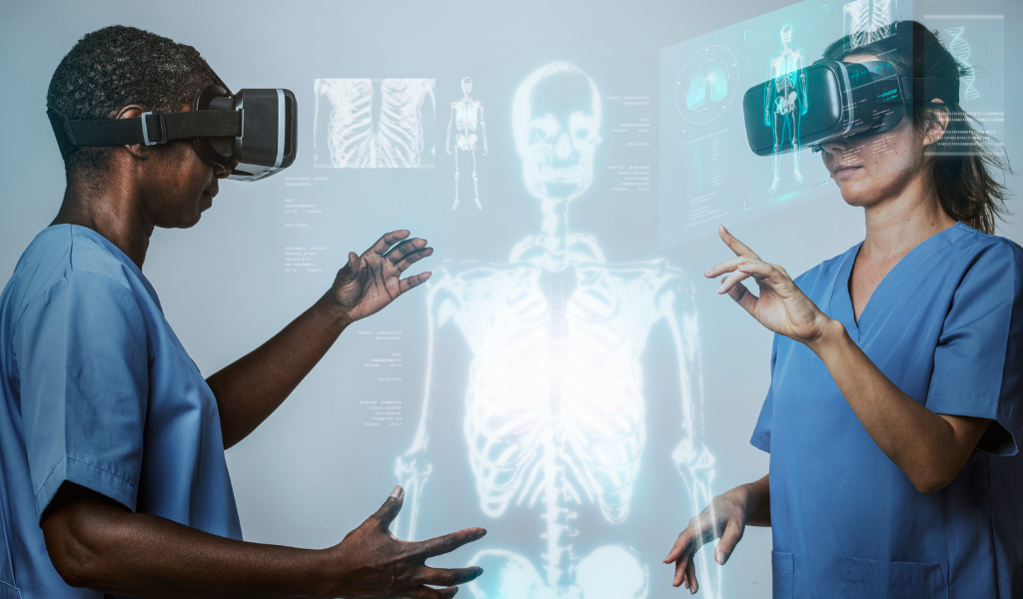
Healthcare
What is Computer Vision in Healthcare?
As surprising as it may sound, computer vision goes back as far as the 1960s, when computers started appearing at universities and scientific labs in large numbers. Back then, the growing infatuation with cybernetics and robotics paved the way for the emergence of several important disciplines, including artificial intelligence and computer vision.

Slide 33
Healthcare
Healthcare was one of the first industries to recognize the immense potential of computer vision and the convolutional neural networks (CNNs) powering the technology. Application of computer vision in the medical field is based on leveraging the capabilities of artificial intelligence and deep learning in a variety of contexts. Let’s name just a few of them:
DICOM image analysis
Detection of anomalies in MRI, CAT and X-ray scans
Diagnostic assistance
Surgical assistance and prevention of inadvertent retention of surgical instruments
Calculation of blood cells
Retina scans and early detection of structural changes
Identification and analysis of new or recurring skin anomalies
Remote monitoring and patient care

Slide 34
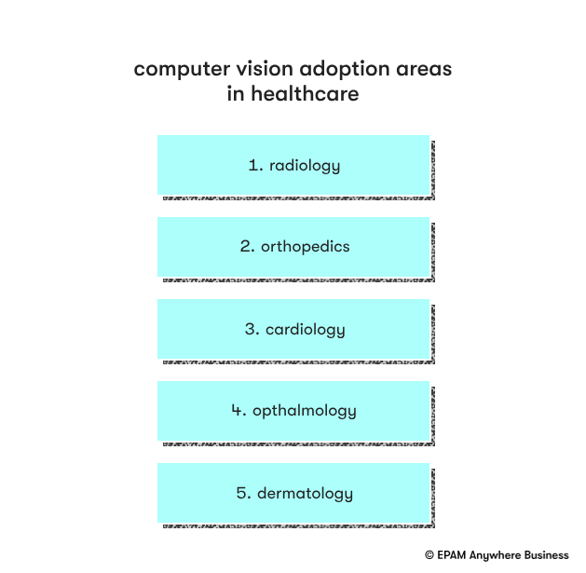
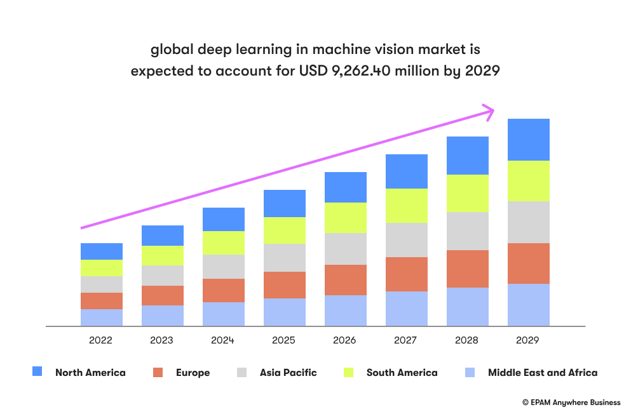
Healthcare

Slide 35
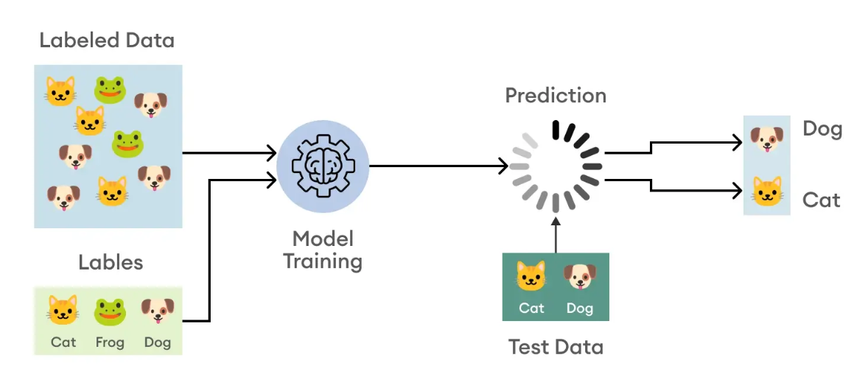
Most popular example Categorization of IMAGES
What is image classification?
Among computer vision tasks, image classification stands out with its irreplaceable role in modern technology. It involves assigning a label or tag to an entire image based on preexisting training data of already labeled images. While the process may appear simple at first glance, it actually entails pixel-level image analysis to determine the most appropriate label for the overall image. This provides us with valuable data and insights, enabling informed decisions and actionable outcomes.

Slide 36
Most popular example Categorization of IMAGES
Structure for performing Image Classification
Image Pre-processing: The aim of this process is to improve the image data (features) by suppressing unwanted distortions and enhancement of some important image features so that the computer vision models can benefit from this improved data to work on. Steps for image pre-processing includes Reading image, Resizing image, and Data Augmentation (Gray scaling of image, Reflection, Gaussian Blurring, Histogram, Equalization, Rotation, and Translation).
Detection of an object: Detection refers to the localization of an object which means the segmentation of the image and identifying the position of the object of interest.
Feature extraction and training: This is a crucial step wherein statistical or deep learning methods are used to identify the most interesting patterns of the image, features that might be unique to a particular class and that will, later on, help the model to differentiate between different classes. This process where the model learns the features from the dataset is called model training.
Classification of the object: This step categorizes detected objects into predefined classes by using a suitable classification technique that compares the image patterns with the target patterns.

Slide 37
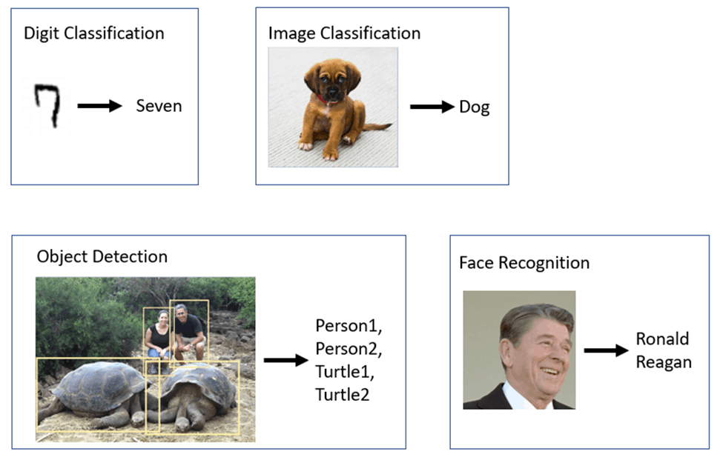
Most popular example Categorization of IMAGES

Slide 38
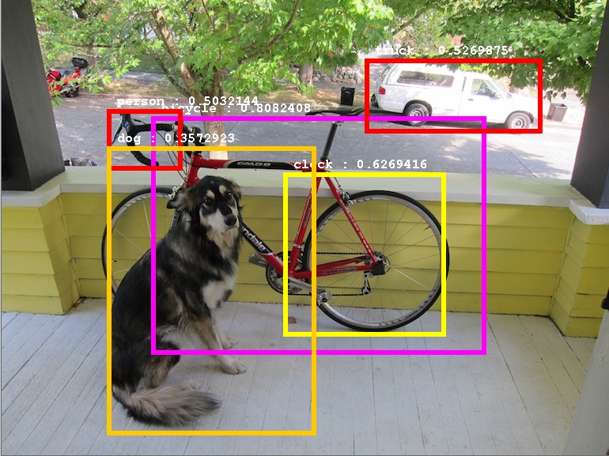
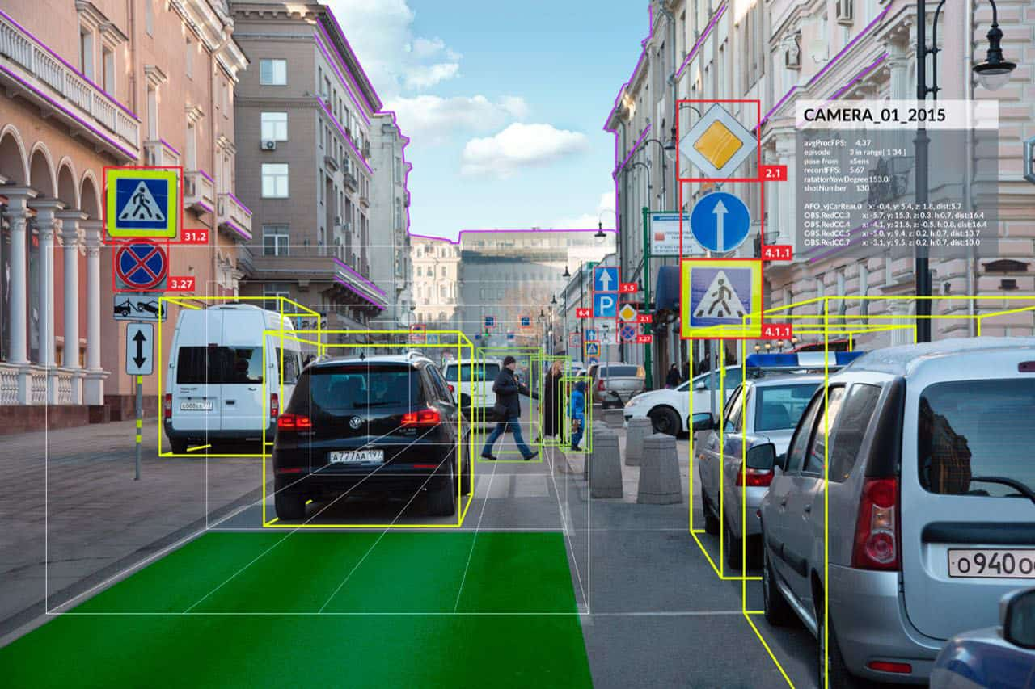
Object Detection

Slide 39
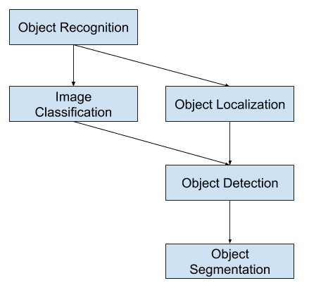
Object Detection
What is Object Recognition?
Object recognition is a general term to describe a collection of related computer vision tasks that involve identifying objects in digital photographs.
Image classification involves predicting the class of one object in an image. Object localization refers to identifying the location of one or more objects in an image and drawing abounding box around their extent. Object detection combines these two tasks and localizes and classifies one or more objects in an image.
When a user or practitioner refers to “object recognition“, they often mean “object detection“.
https://machinelearningmastery.com/object-recognition-with-deep-learning/

Slide 40
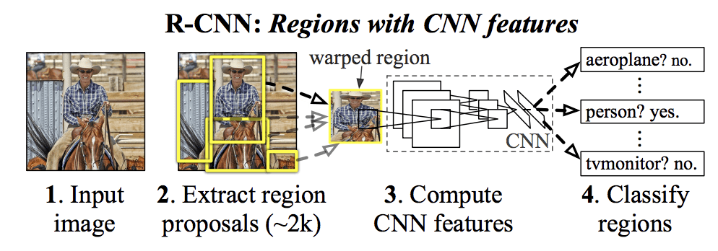
Object Detection
distinguish between these three computer vision tasks:
Image Classification: Predict the type or class of an object in an image.
Input: An image with a single object, such as a photograph.
Output: A class label (e.g. one or more integers that are mapped to class labels).
Object Localization: Locate the presence of objects in an image and indicate their location with a bounding box.
Input: An image with one or more objects, such as a photograph.
Output: One or more bounding boxes (e.g. defined by a point, width, and height).
Object Detection: Locate the presence of objects with a bounding box and types or classes of the located objects in an image.
Input: An image with one or more objects, such as a photograph.
Output: One or more bounding boxes (e.g. defined by a point, width, and height), and a class label for each bounding box.

Slide 41
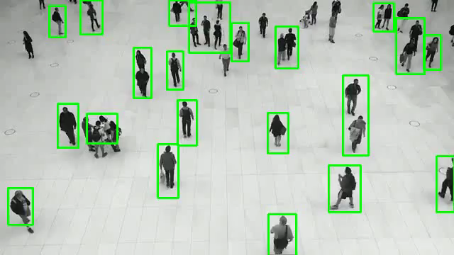
Observation of Moving Objects

Slide 42
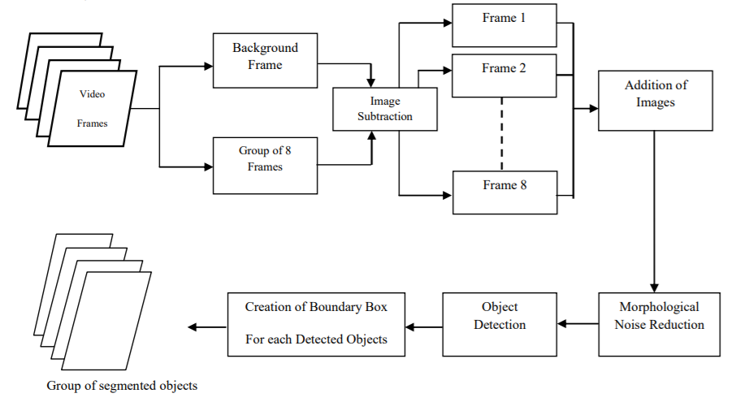
Observation of Moving Objects
Steps for Moving Object Detection using Frame Differencing and Summing
Detecting moving objects using frame differencing and summing involves some simple steps.
The authors have described it quite well in the paper. We will go through the steps briefly in this tutorial.
Let’s observe the block diagram which shows the complete procedure.
Figure 1. Figure illustrating the steps for moving object detection using frame differencing

Slide 43
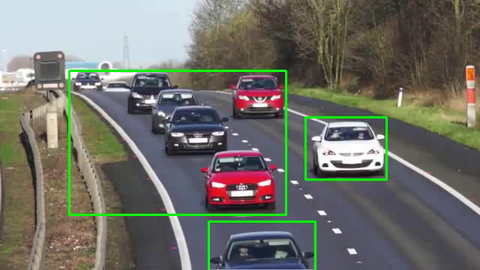
Observation of Moving Objects
https://debuggercafe.com/moving-object-detection-using-frame-differencing-with-opencv/

Slide 44
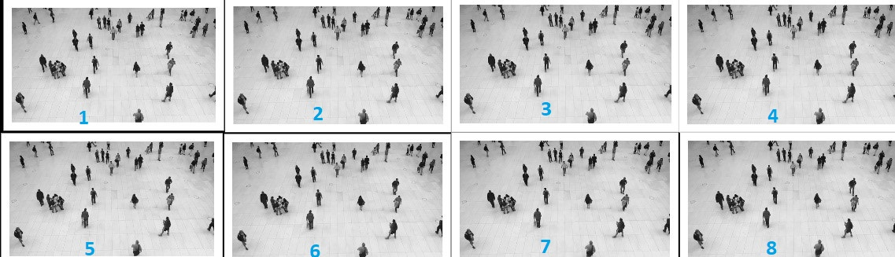
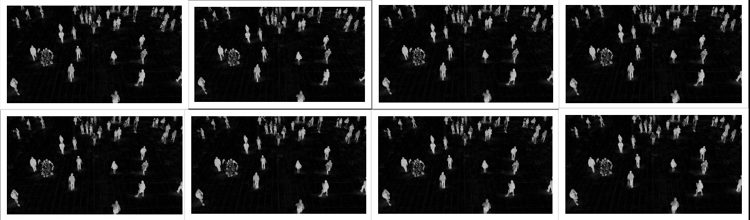
Observation of Moving Objects

Slide 45
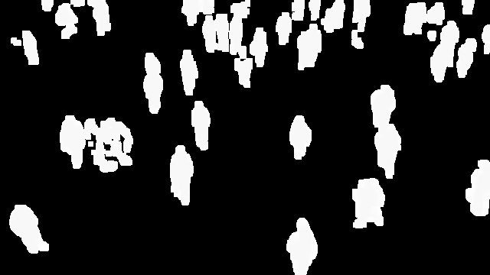
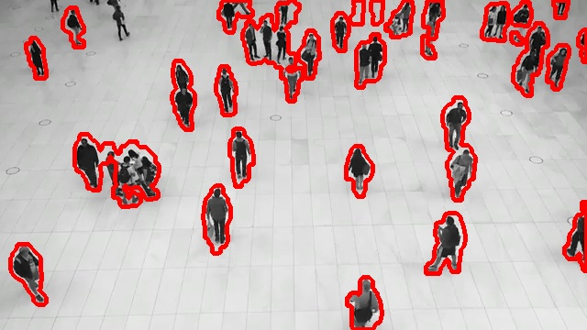
Observation of Moving Objects
Moving Object Detection and Segmentation
Step 1: Read 8 Consecutive Frames from the Video
Step 2: Convert the Frames into Grayscale
Step 3: Frame Differencing
Step 4: Add the 8 Frames
Step 5: Fill the Gaps Inside the Objects
Step 6: Convert to Binary
Step 7: Remove Noise from the Resulting Image

Slide 46
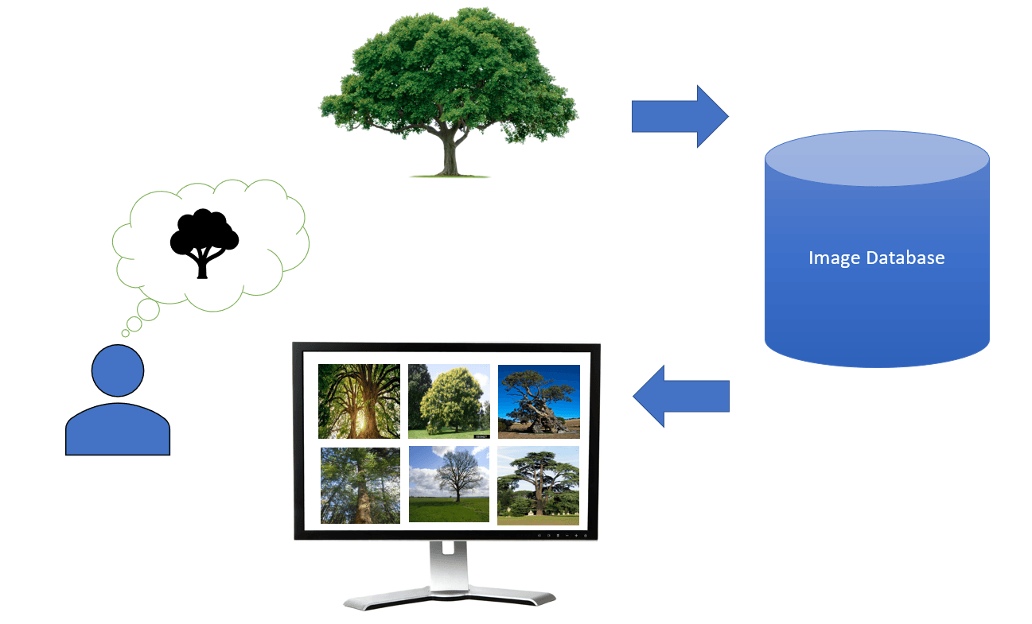
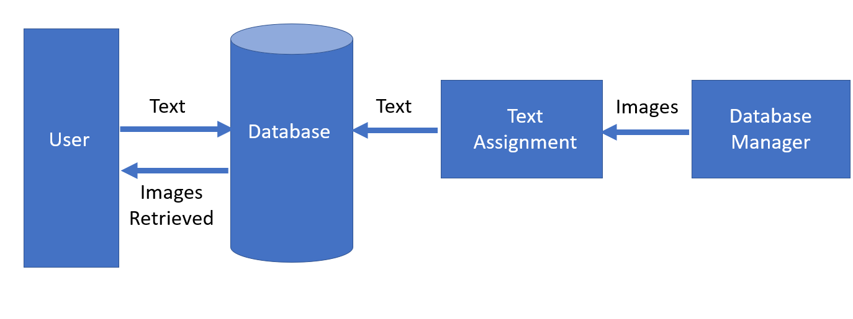
Retrieval of Images Based on Their Contents
The retrieval of images based on their content is known as content-based image retrieval (CBIR). CBIR aims to find images that are visually similar or relevant to a given query image, without relying on textual metadata or annotations. It relies on the visual features extracted from the images themselves to perform the search.

Slide 47
Retrieval of Images Based on Their Contents
Feature Extraction: The first step is to extract meaningful features from the images. Various low-level and high-level visual features can be used, such as color histograms, texture descriptors, shape descriptors, deep learning features (e.g., features from convolutional neural networks), or a combination of these. The choice of features depends on the specific requirements and characteristics of the image dataset.
Feature Representation: The extracted features are then typically transformed into a suitable representation for efficient indexing and retrieval. This can involve techniques like vector quantization, dimensionality reduction (e.g., using techniques like Principal Component Analysis or t-SNE), or feature aggregation.
Indexing: The transformed feature representations are organized in a way that enables fast search and retrieval. Indexing structures like inverted files, k-d trees, or hash-based methods are commonly used to efficiently index the feature data.
Similarity Measurement: When a query image is provided, its features are extracted and compared to the features in the indexed database. Various similarity or distance measures, such as Euclidean distance, cosine similarity, or the Jaccard index, can be used to quantify the similarity between the query features and the features of the indexed images.
Ranking and Retrieval: Based on the similarity measurements, the indexed images are ranked in descending order of relevance to the query. The most similar images are returned as the retrieval results.

Slide 48
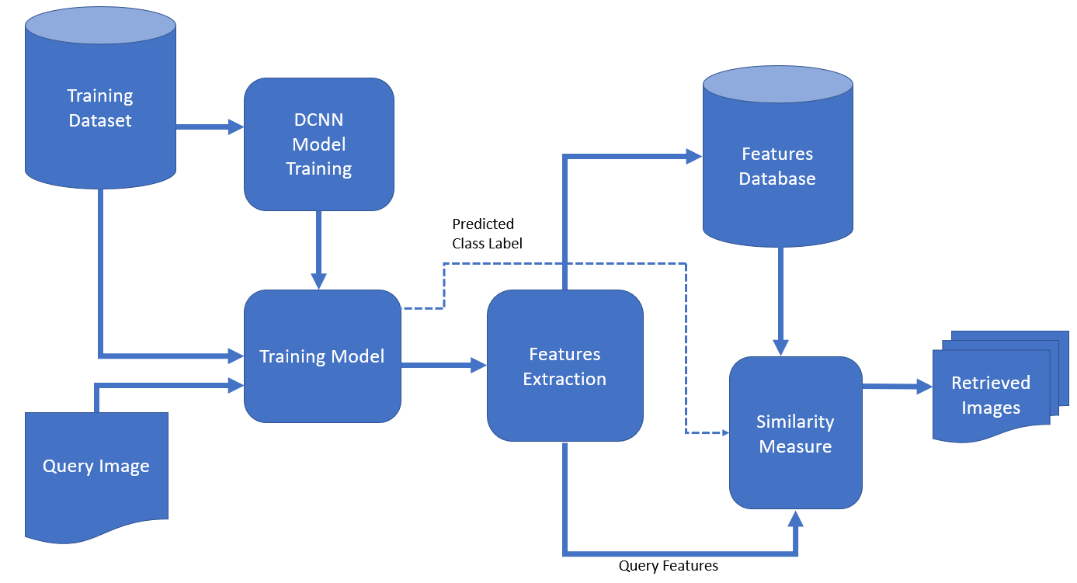
Retrieval of Images Based on Their Contents
Recently, state-of-the-art CBIR systems have started using machine-learning methods such as deep-learning algorithms. They can perform feature extraction far better than traditional methods.
Usually, a Deep Convolutional Neural Network (DCNN) is trained using available data. Its job is to extract features from images. So, when a user sends the query image to the database system, DCNN extracts its features. Then, the query-image features are compared to those of the database images. In that step, the database system finds the most similar images using similarity measures and returns them to the user:

Slide 49
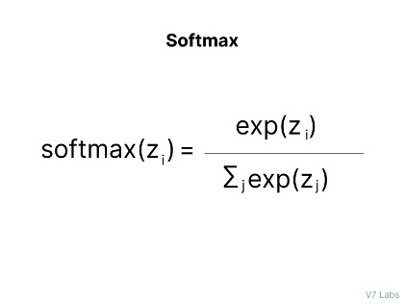
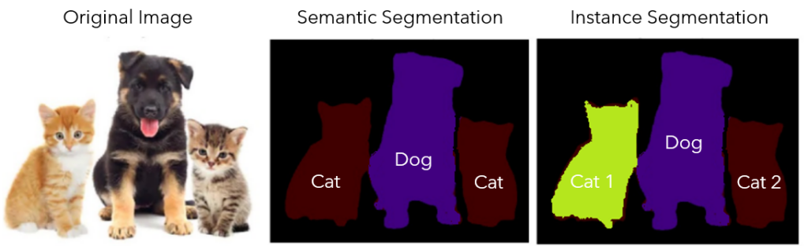
Instance segmentation
Instance Segmentation is a special form of image segmentation that deals with detecting instances of objects and demarcating their boundaries. It finds large-scale applicability in real-world scenarios like self-driving cars, medical imagining, aerial crop monitoring, and more.
What is Instance Segmentation?
Instance Segmentation is the technique of detecting, segmenting, and classifying every individual object in an image.

Slide 50
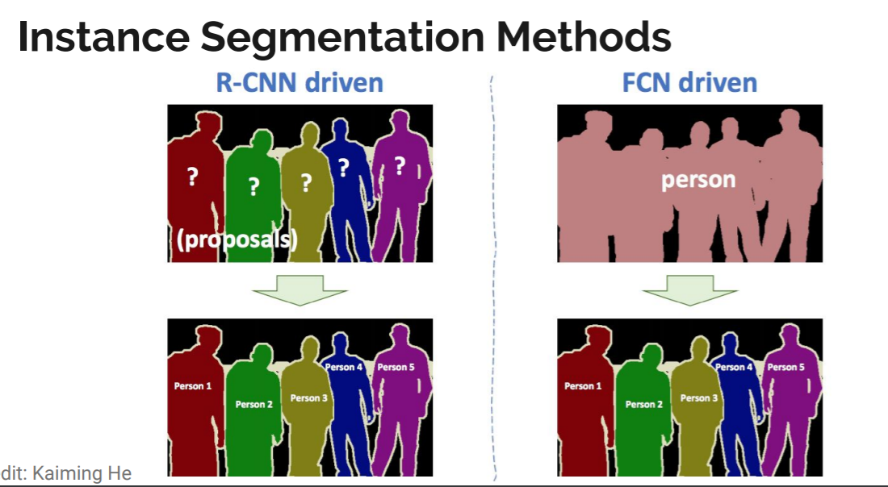
Instance segmentation
How does Instance Segmentation work?
Instance Segmentation is a challenging task and requires the detection of multiple instances of different objects present in an image along with their per-pixel segmentation mask.
Instance Segmentation methods can be both R-CNN driven or FCN driven

Slide 51
Instance segmentation
Instance Segmentation applications
Self-driving cars
Medical scans
Satellite imagery
How to train an Instance Segmentation model on V7
1. Upload data
2. Create new annotation classes
3. Auto-annotate your images or videos
4. Check for class balance
5. Train your model
Instance Segmentation: Key Takeaways
Instance segmentation is an important domain of Computer Vision, offering a combination of object detection and semantic segmentation tasks.

Slide 52
Convolutional Neural Networks
What are convolutional neural networks?
Convolutional neural networks are distinguished from other neural networks by their superior performance with image, speech, or audio signal inputs. They have three main types of layers, which are:
Convolutional layer
Pooling layer
Fully-connected (FC) layer

Slide 53
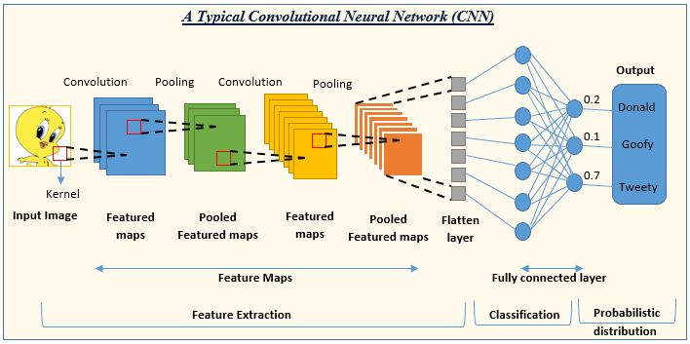
Convolutional Neural Networks

Slide 54
Convolutional Neural Networks
1.Convolutional Layer:-The convolutional layer is the core building block of a CNN, and it is where the majority of computation occurs. It requires a few components, which are input data, a filter, and a feature map. Let’s assume that the input will be a color image, which is made up of a matrix of pixels in 3D. This means that the input will have three dimensions—a height, width, and depth—which correspond to RGB in an image. We also have a feature detector, also known as a kernel or a filter, which will move across the receptive fields of the image, checking if the feature is present. This process is known as a convolution.
2.Pooling Layer:-Pooling layers, also known as down sampling, conducts dimensionality reduction, reducing the number of parameters in the input. Similar to the convolutional layer, the pooling operation sweeps a filter across the entire input, but the difference is that this filter does not have any weights. Instead, the kernel applies an aggregation function to the values within the receptive field, populating the output array. There are two main types of pooling:
Max pooling: As the filter moves across the input, it selects the pixel with the maximum value to send to the output array. As an aside, this approach tends to be used more often compared to average pooling.
Average pooling: As the filter moves across the input, it calculates the average value within the receptive field to send to the output array.
3.Fully-Connected Layer:-The name of the full-connected layer aptly describes itself. As mentioned earlier, the pixel values of the input image are not directly connected to the output layer in partially connected layers. However, in the fully-connected layer, each node in the output layer connects directly to a node in the previous layer.

Slide 55

Convolutional Neural Networks

Slide 56
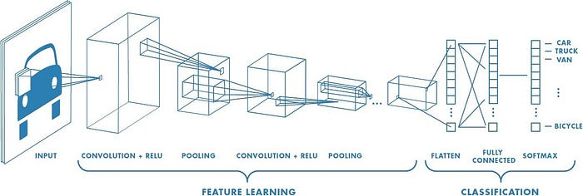
Evolution of CNN Architectures for Image
It all started with LeNet in 1998 and eventually, after nearly 15 years, lead to ground breaking models winning the ImageNet Large Scale Visual Recognition Challenge which includes AlexNet in 2012 to GoogleNet in 2014 to ResNet in 2015 to ensemble of previous models in 2016. In the last 2 years, no significant progress has been made and the new models are an ensemble of previous ground breaking models.

Slide 57
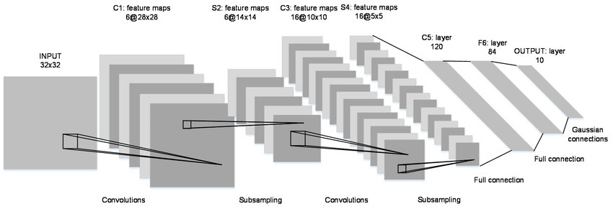
Evolution of CNN Architectures for Image
A Convolutional Neural Network (CNN, or ConvNet) are a special kind of multi-layer neural networks, designed to recognize visual patterns directly from pixel images with minimal preprocessing. The ImageNet project is a large visual database designed for use in visual object recognition software research
LeNet in 1998
LeNet is a 7-level convolutional network by LeCun in 1998 that classifies digits and used by several banks to recognize hand-written numbers on cheques digitized in 32x32 pixel greyscale input images. The ability to process higher resolution images requires larger and more convolutional layers, so this technique is constrained by the availability of computing resources.

Slide 58
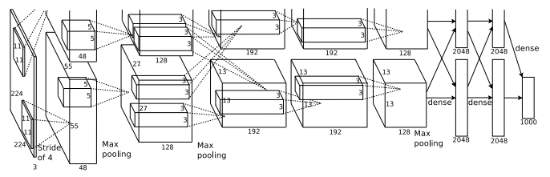
Evolution of CNN Architectures for Image
AlexNet in 2012
AlexNet is considered to be the first paper/ model which rose the interest in CNNs when it won the ImageNet challenge in 2012. AlexNet is a deep CNN trained on ImageNet and outperformed all the entries that year. It was a major improvement with the next best entry getting only 26.2% top 5 test error rate. Compared to modern architectures, a relatively simple layout was used in this paper.

Slide 59
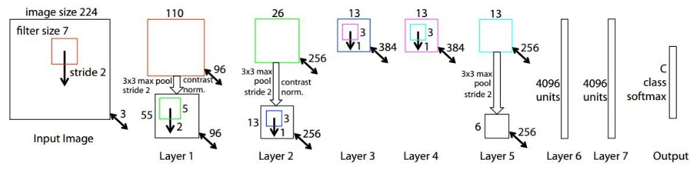
Evolution of CNN Architectures for Image
ZFNet in 2013
ZFNet is a modified version of AlexNet which gives a better accuracy.
One major difference in the approaches was that ZF Net used 7x7 sized filters whereas AlexNet used 11x11 filters. The intuition behind this is that by using bigger filters we were losing a lot of pixel information, which we can retain by having smaller filter sizes in the earlier conv layers. The number of filters increase as we go deeper. This network also used ReLUs for their activation and trained using batch stochastic gradient descent.

Slide 60
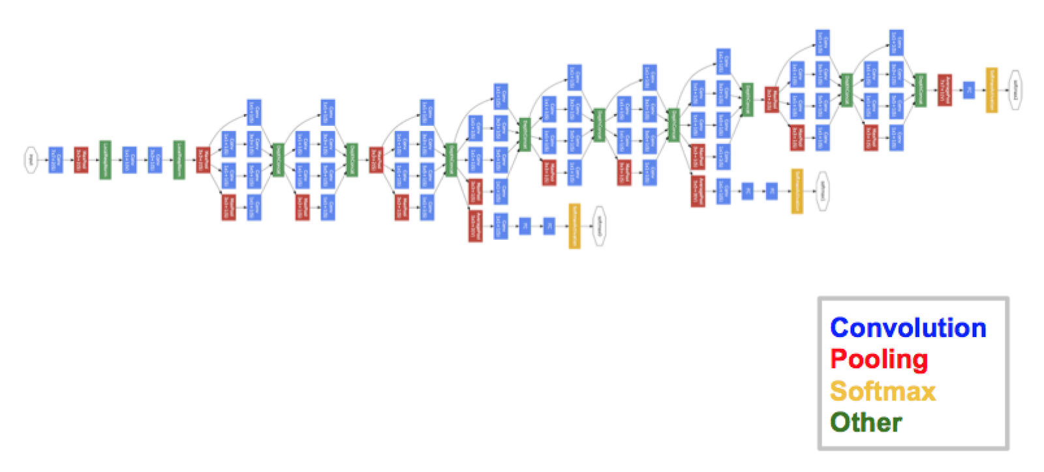
Evolution of CNN Architectures for Image
GoogleNet in 2014
In 2014, several great models were developed like VGG but the winner of the ImageNet contest was GoogleNet.
GoogLeNet proposed a module called the inception modules which includes skip connections in the network forming a mini module and this module is repeated throughout the network.

Slide 61
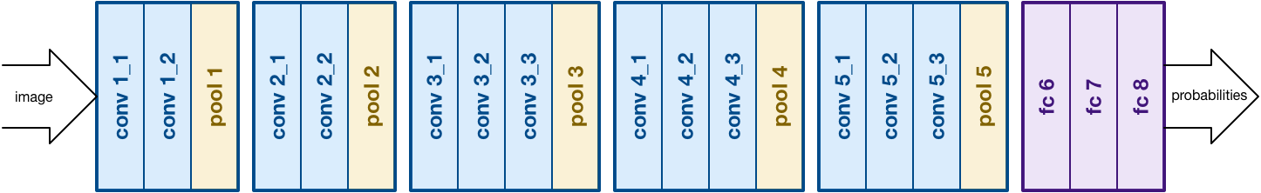
Evolution of CNN Architectures for Image
VGG in 2014
The idea of VGG was submitted in 2013 and it became a runner up in the ImageNet contest in 2014. It is widely used as a simple architecture compared to AlexNet and ZFNet.
VGG Net used 3x3 filters compared to 11x11 filters in AlexNet and 7x7 in ZFNet. The authors give the intuition behind this that having two consecutive 2 consecutive 3x3 filters gives an effective receptive field of 5x5, and 3 – 3x3 filters give a receptive field of 7x7 filters, but using this we can use a far less number of hyper-parameters to be trained in the network.

Slide 62
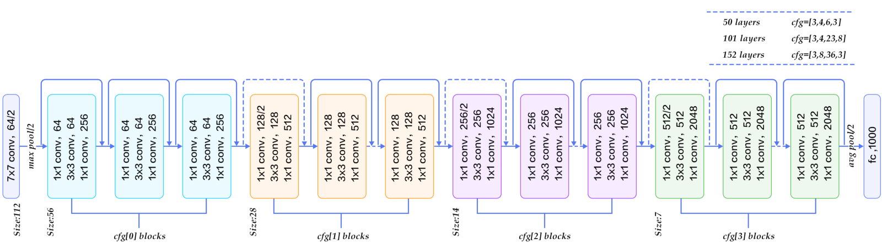
Evolution of CNN Architectures for Image
ResNet in 2015
There are 152 layers in the Microsoft ResNet. The authors showed empirically that if you keep on adding layers the error rate should keep on decreasing in contrast to “plain nets” where adding a few layers resulted in higher training and test errors. It took two to three weeks to train it on an 8 GPU machine. One intuitive reason why residual blocks improve classification is the direct step from one layer to the next and intuitively using all these skip steps form a gradient highway where the gradients computed can directly affect the weights in the first layer making updates have more effect.
https://iq.opengenus.org/evolution-of-cnn-architectures/

Slide 63
Faculty Video Links, Youtube & NPTEL Video Links and Online Courses Details
Youtube/other Video Links
https://nptel.ac.in/courses/106106093/
https://www.youtube.com/watch?v=m-aKj5ovDfg
https://www.youtube.com/watch?v=G4NYQox4n2g

Slide 64
DAILY QUIZ
What is computer vision?
Name three common applications of computer vision.
What is the purpose of image segmentation in computer vision?
What is the difference between object detection and object recognition?
Explain the concept of convolution in convolutional neural networks (CNNs).

Slide 65
DAILY QUIZ
What is optical character recognition (OCR) used for in computer vision?
What is the purpose of non-maximum suppression in object detection algorithms?
What are some common challenges faced in computer vision tasks?
What is the difference between supervised and unsupervised learning in computer vision?
Name three popular deep learning architectures used in computer vision.

Slide 66
WEEKLY ASSIGNMENT
Explain the concept of image filtering and provide examples of commonly used filters in computer vision.
Discuss the differences between image classification and object detection in computer vision. Provide examples of each.
Explain the process of feature extraction in computer vision. How are features used in tasks like object recognition or image matching?
Describe the steps involved in building a convolutional neural network (CNN) for image classification. Discuss the purpose of each step.

Slide 67
WEEKLY ASSIGNMENT
Discuss the challenges and potential solutions for handling occlusion in object detection algorithms.
Compare and contrast traditional computer vision techniques with deep learning-based approaches. What are the advantages and limitations of each?
Explain the concept of image segmentation and its applications in computer vision. Discuss different segmentation methods.
Discuss the concept of optical flow in computer vision. How is it used to analyze motion in videos or sequences of images?
Explain the concept of image registration and its applications in computer vision. Provide examples of scenarios where image registration is useful.
Discuss the role of data augmentation techniques in computer vision tasks. How can data augmentation improve the performance of deep learning models?

Slide 68
WEEKLY ASSIGNMENT
Explain the concept of object tracking in computer vision. Discuss different algorithms or techniques used for object tracking.
Describe the process of image recognition using convolutional neural networks (CNNs). What are the key components and steps involved?
Discuss the concept of depth estimation in computer vision. Explain how depth information can be extracted from 2D images.
Explain the concept of image stitching and its applications. How are multiple images combined to create a panoramic image?
Discuss the challenges and approaches for handling scale invariance in object detection algorithms.
Describe the concept of facial recognition in computer vision. Discuss its applications, advantages, and potential privacy concerns.
Explain the concept of semantic segmentation and its applications in computer vision. Provide examples of scenarios where semantic segmentation is useful.
Discuss the concept of object recognition using feature descriptors. Explain popular feature descriptor algorithms such as SIFT or SURF.
Explain the concept of image super-resolution and its applications. How can low-resolution images be enhanced to improve their quality?
Discuss the role of transfer learning in computer vision. How can pre-trained models be utilized for new tasks or datasets?

Slide 69
MCQ s
Question 1: What is computer vision?
A. The study of computers and their components
B. The field of processing and understanding visual data by computers
C. The development of computer software for image editing
D. The study of visual perception in humans
Question 2: Which of the following is an application of computer vision?
A. Speech recognition
B. Natural language processing
C. Object detection
D. Network security
Question 3: Which technique is commonly used for feature extraction in computer vision?
A. Convolutional Neural Networks (CNN)
B. Decision Trees
C. Support Vector Machines (SVM)
D. K-means clustering

Slide 70
MCQ s
Question 4: What is the purpose of image segmentation in computer vision?
A. Classifying images into different categories
B. Detecting and recognizing objects in images
C. Enhancing and manipulating image quality
D. Dividing an image into meaningful regions or segments
Question 5: Which of the following is an example of an object recognition task in computer vision?
A. Determining the sentiment of an image
B. Identifying the boundaries of objects in an image
C. Recognizing specific objects in an image, such as cars or faces
D. Analyzing the texture or color distribution of an image
Question 6: Which technique is commonly used for image classification in computer vision?
A. Principal Component Analysis (PCA)
B. Naive Bayes classifier
C. Latent Semantic Analysis (LSA)
D. Convolutional Neural Networks (CNN)

Slide 71
MCQ s(CONT’d)
What is computer vision? Answer: c. Computer vision is a field of artificial intelligence that focuses on enabling computers to interpret and understand visual information from images or videos.
Name three common applications of computer vision. Answer: a. Autonomous vehicles, b. Object recognition, c. Medical image analysis
What is the purpose of image segmentation in computer vision? Answer: b. Image segmentation aims to partition an image into meaningful regions or segments to facilitate object detection, tracking, or analysis.
What is the difference between object detection and object recognition? Answer: c. Object detection involves both localizing and classifying objects within an image, while object recognition focuses solely on identifying objects without localizing them.
Explain the concept of convolution in convolutional neural networks (CNNs). Answer: a. Convolution involves applying a filter/kernel to an input image or feature map, computing element-wise multiplications, and summing the results to produce a feature map.

Slide 72
MCQ s(CONT’d)
What is optical character recognition (OCR) used for in computer vision? Answer: b. OCR is used to convert printed or handwritten text from images into machine-readable text, enabling automated text analysis or data extraction.
What is the purpose of non-maximum suppression in object detection algorithms? Answer: a. Non-maximum suppression is used to eliminate redundant bounding box detections by keeping only the most confident detection and suppressing overlapping or lower-confidence detections.
What are some common challenges faced in computer vision tasks? Answer: c. Variations in lighting conditions, occlusion, viewpoint changes, and limited labeled data are common challenges in computer vision tasks.
What is the difference between supervised and unsupervised learning in computer vision? Answer: b. Supervised learning requires labeled training data, where input images are associated with corresponding ground-truth labels. Unsupervised learning involves learning patterns or structures from unlabeled data without explicit labels.

Slide 73
SUMMARY
Computer vision is a field of study that deals with the extraction of information from images or videos to understand and interpret visual data. It involves the development of algorithms and techniques to enable computers to perceive and understand the visual world in a way similar to humans.
Computer vision encompasses various tasks and applications, including image classification, object detection, image segmentation, facial recognition, scene understanding, and video analysis. These tasks involve processing and analyzing visual data to extract meaningful information and make decisions based on it.
The fundamental concepts in computer vision include image formation, image processing, feature extraction, and pattern recognition. Image formation deals with how images are captured and represented using pixels. Image processing techniques are used to enhance and manipulate images to improve their quality or extract specific information. Feature extraction involves identifying relevant visual characteristics or patterns from images that can be used for tasks like object recognition or tracking.

Slide 74
SUMMARY
Computer vision techniques employ both traditional computer vision algorithms and deep learning approaches. Traditional algorithms rely on handcrafted features and mathematical models to process and analyze visual data. Deep learning methods, particularly convolutional neural networks (CNNs), have gained popularity in recent years due to their ability to learn directly from raw pixel data and achieve state-of-the-art results in various computer vision tasks.
Computer vision finds applications in diverse fields such as autonomous vehicles, surveillance systems, medical imaging, robotics, augmented reality, and industrial automation. It plays a crucial role in enabling machines to understand and interact with the visual world, opening up possibilities for advanced applications and advancements in numerous domains.
As computer vision continues to evolve, researchers and practitioners explore new techniques, algorithms, and applications to tackle more complex challenges and improve the accuracy and efficiency of visual understanding by machines.

Slide 75
REFERENCES
"Computer Vision: Algorithms and Applications" by Richard Szeliski
This comprehensive book covers the fundamental concepts and algorithms in computer vision, including image formation, image features, stereo vision, multiple view geometry, and object recognition. It also includes numerous examples and MATLAB code snippets.
"Deep Learning for Computer Vision with Python" by Adrian Rosebrock
This book focuses on applying deep learning techniques to solve computer vision problems. It covers topics such as convolutional neural networks (CNNs), image classification, object detection, and image segmentation. The book provides practical examples and code implementations using Python and the Keras library.
"Computer Vision: Models, Learning, and Inference" by Simon J.D. Prince
This book provides a comprehensive introduction to computer vision, covering various topics such as image formation, filtering, feature detection and matching, object recognition, and 3D reconstruction. It also includes discussions on statistical and probabilistic models in computer vision.
https://www.oreilly.com/library/view/datawarehousingarchitecture/0130809020/ch07.html
https://www.slideshare.net/2cdude/data-warehousing-3292359

Slide 76
Any Certification/Courses for this subject
Course Name | Offered By | Duration | Rating | Link
Introduction to Computer Vision and Image Processing | IBM | 1-4 weeks | 4.4 | https://www.coursera.org/learn/introduction-computer-vision-watson-opencv#about
Computer Vision Basics | University at Buffalo | 1-4 weeks | 4.2 | https://www.coursera.org/learn/computer-vision-basics#syllabus

Slide 77

OPTIONAL / CASE STUDIES
OPTIONAL / CASE STUDIES
Factors influencing the adoption of new mobility technologies and services:,
1 Drone Systems and Applications ( Healthcare, Agriculture, Security)
2 Autonomous Vehicular System
3 Motion Prediction for Autonomous Vehicles
4 Clinical applications Robotic surgery

Slide 78
Thank You

